Slide 1
Cantara Purchase Order Mobile Applications
MAY 2020

Slide 2
Copyright © 2020, Rinami Pty Ltd and/or its affiliates. All rights reserved. Oracle and Java are registered trademarks of Oracle and/or its affiliates. Other names may be trademarks of their respective owners.
This presentation is provided for information purposes only, and the contents hereof are subject to change without notice. This presentation is not warranted to be error-free, nor subject to any other warranties or conditions, whether expressed orally or implied in law, including implied warranties and conditions of merchantability or fitness for a particular purpose. We specifically disclaim any liability with respect to this presentation, and no contractual obligations are formed either directly or indirectly by this presentation. This presentation may not be reproduced or transmitted in any form or by any means, electronic or mechanical, for any purpose, without our prior written permission.

Slide 3
Rinami and DXC Red Rock
Rinami is an ICT services provider formed in 2009 to deliver services to asset intensive businesses. The business has grown to now deliver integration systems, custom mobile applications and expert consulting services to Oracle JD Edwards customers across the world. Oracle's JD Edwards EnterpriseOne is an integrated applications suite of comprehensive Enterprise Resource Planning (ERP) software, used by organisations worldwide across multiple asset intensive businesses including mining and resources, agribusiness, logistics, multi-mode manufacturing, services, and local government sectors.
DXC Red Rock is the largest Oracle JD Edwards consulting organisation in Australia and New Zealand. Our team of over 100 specialist consultants leverage Oracle technology to deliver dynamic, industry-specific solutions designed to manage the complexities of global business environments. With an absolute commitment to technical and service excellence, UXC Red Rock has completed more JD Edwards implementations and upgrades than any other regional partner. This ranks us amongst Oracle's top five JD Edwards implementation partners globally.
Rinami and DXC Red Rock have been partners in Australia and New Zealand since 2017. The Rinami Cantara product enables DXC Red Rock to deliver seamless integration to Oracle JD Edwards to enable new technologies such as Mobile, Wearables and IOT. DXC Red Rock provides dedicated solution delivery and support services through experienced resources located in Australia.

Slide 4
Solution Overview
The Cantara Purchase Order mobile application supports the following transactions and activities in one application. A revised Cantara Cloud pricing model based on using one application.
Revised Pricing Benefits
Purchase Order Approvals
Approve/Reject
Add Approve/Reject Comments
Review attachments (Text, Image, Document, URL)
Receive Push Notifications of waiting Approvals
Purchase Order Entry
Raise Requisition
Enter text attachments

Slide 5
Revised Pricing Structure
40% Cantara Cloud price reduction in overall Cloud pricing based on the One application pricing model
40% Price difference reduction between previous Cantara On Premise proposal and the new One application Cantara Cloud pricing model (based on 100 users)
FREE Purchase Order approvals module (both iOS and Android)
60% savings in overall fixed price delivery of the solution
Mobile application based on the latest Cantara Client 6 technology

Slide 6
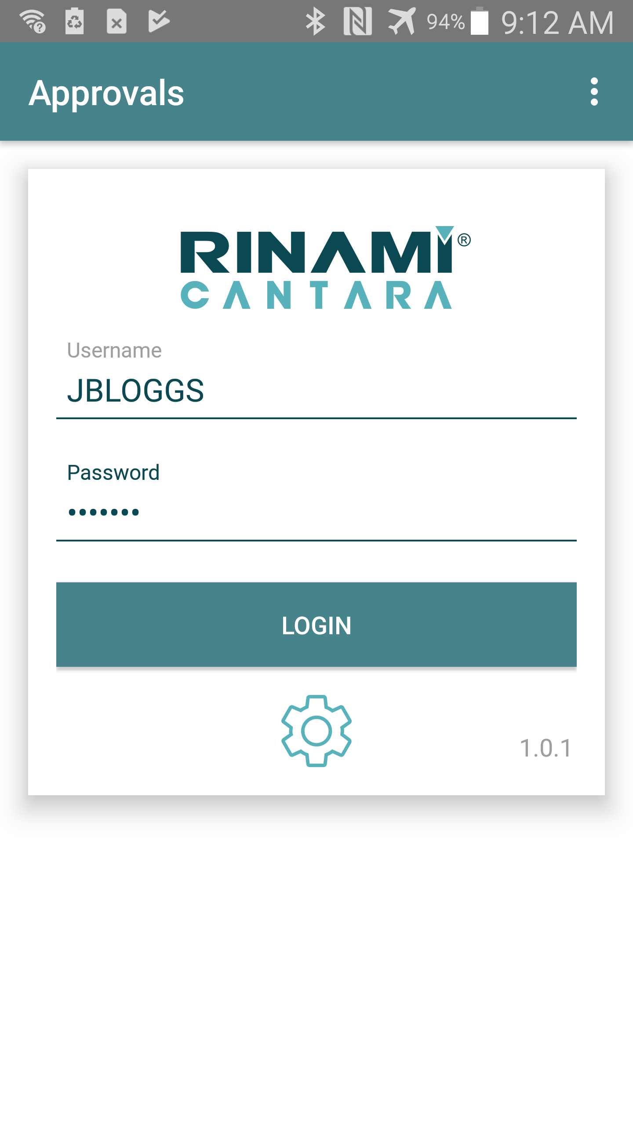
Applications Logon
Enter your JDE Username and Password and click the Login button to access the application

Slide 7
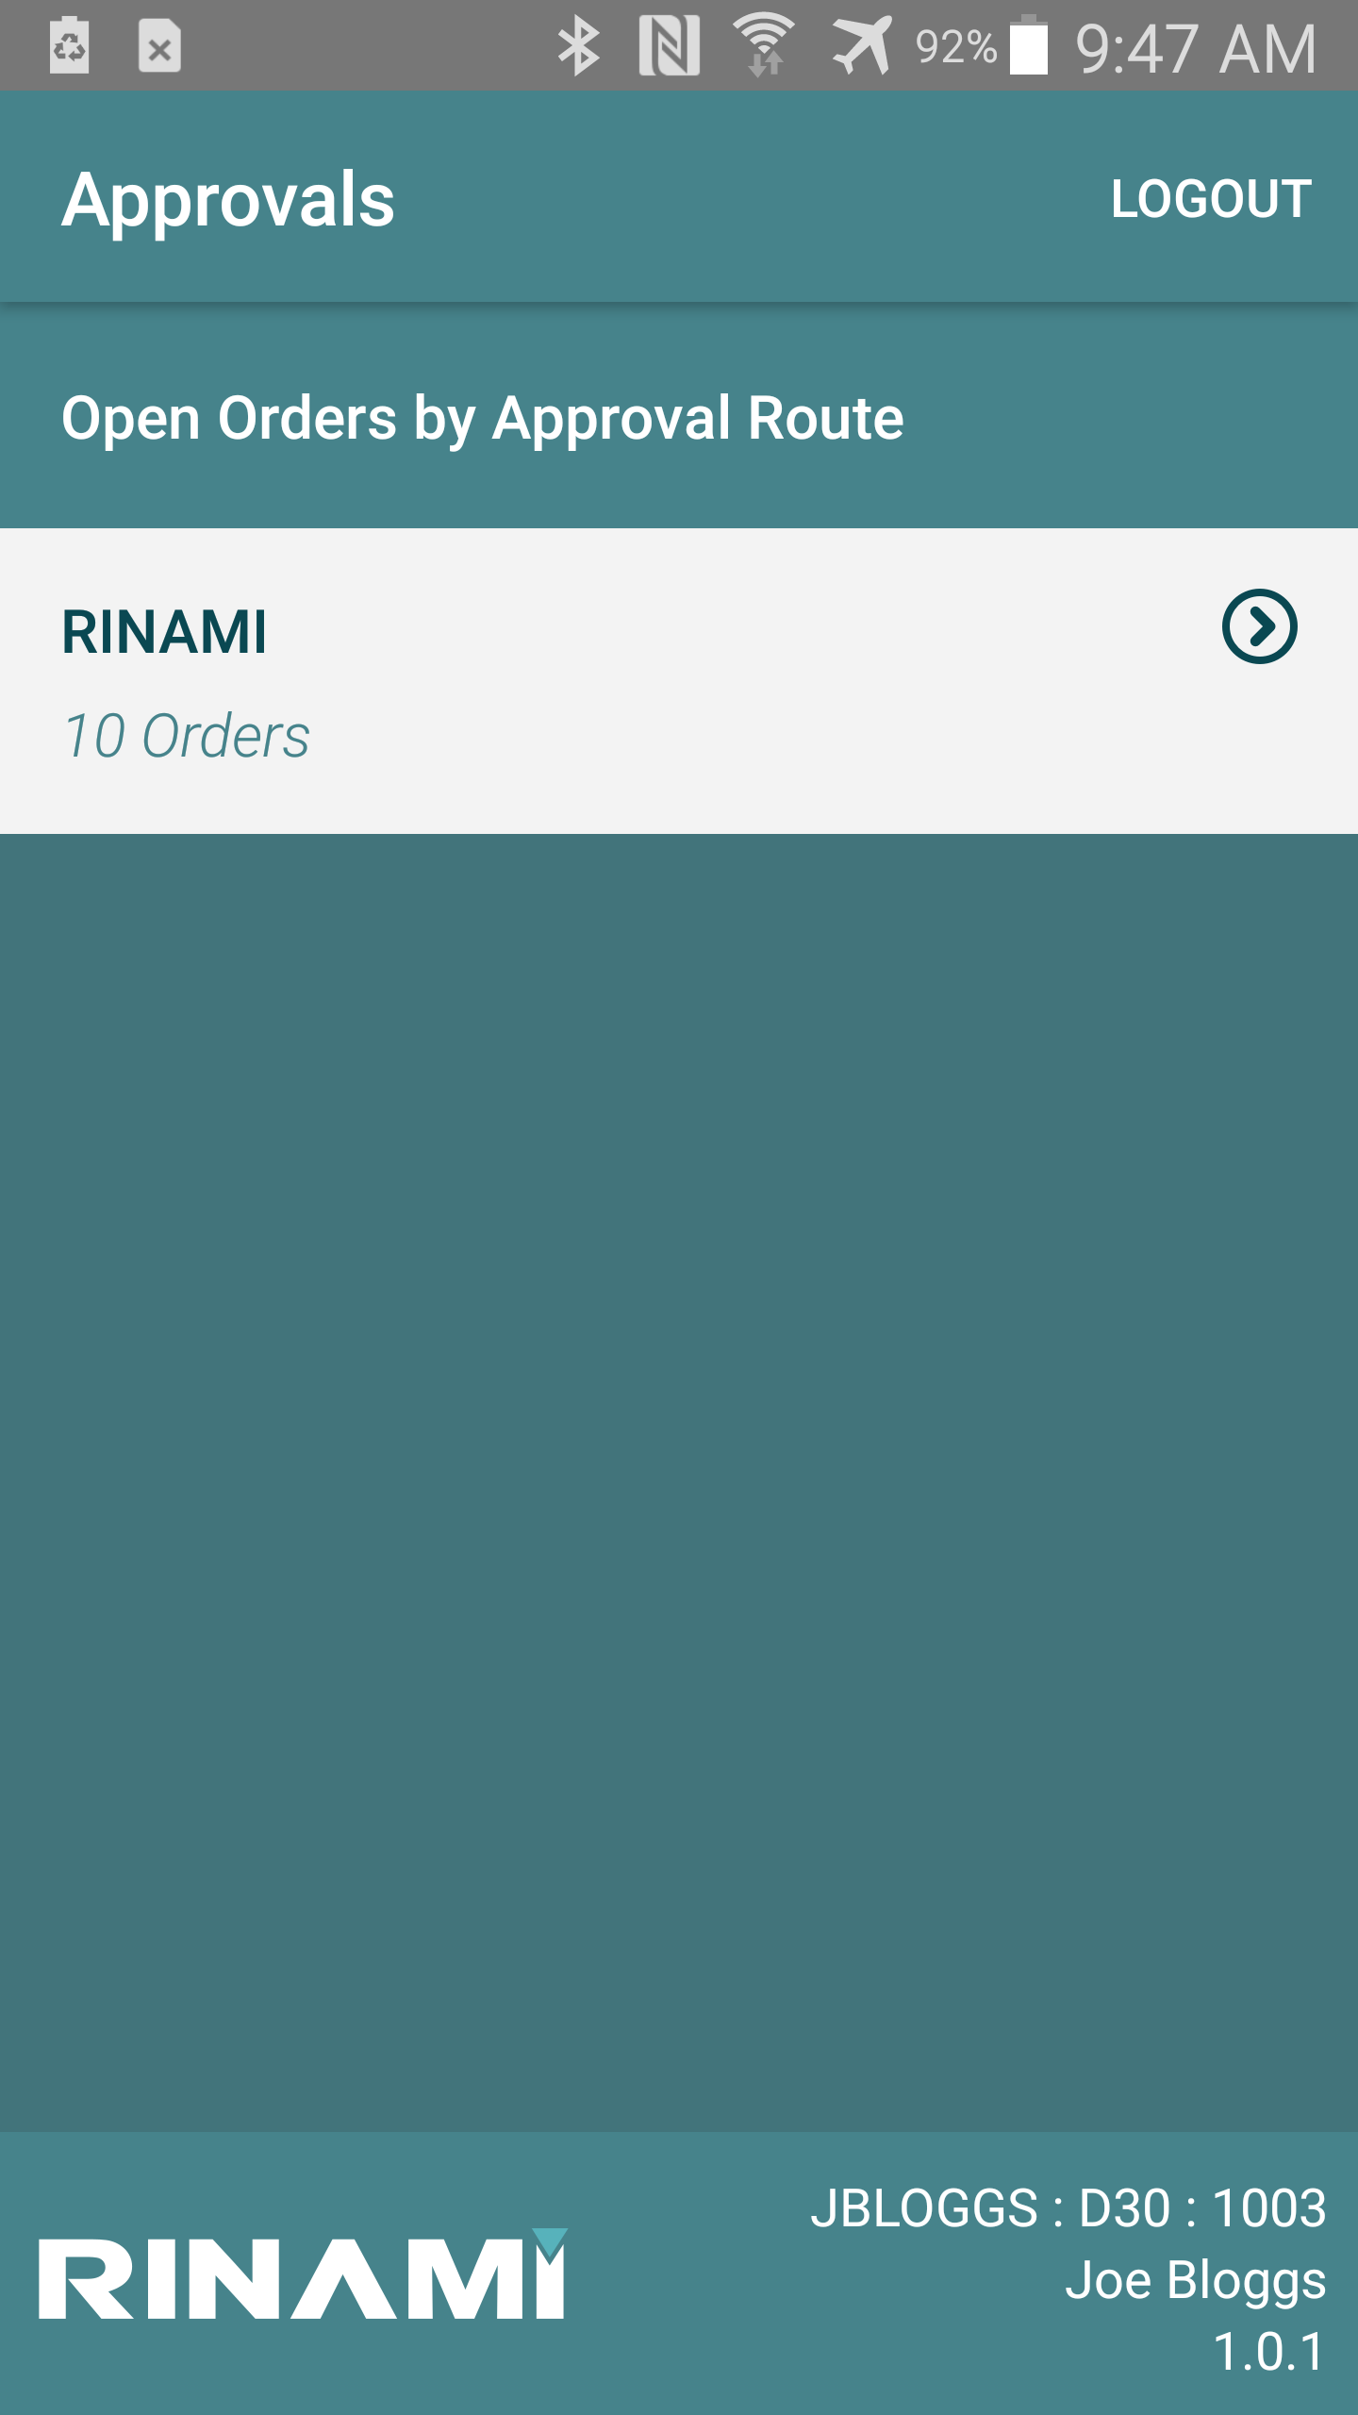
Approvals Routes List
The Approval Routes list is the main screen for the approvals application.
If you have orders to approve against multiple approval routes, then you will see this screen at login.
If you only have orders against a single approval route (e.g. RINAMI route) then you will be taken straight to the Unapproved Orders List (see next section).

Slide 8
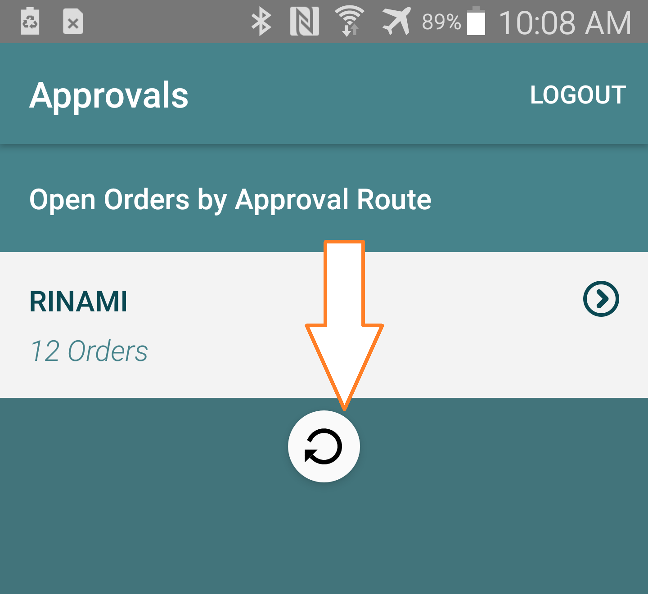
Approvals Routes List cont..
Swipe down, then release to trigger the approvals list to be reloaded.
As you swipe down, you will see a reload icon appear.

Slide 9
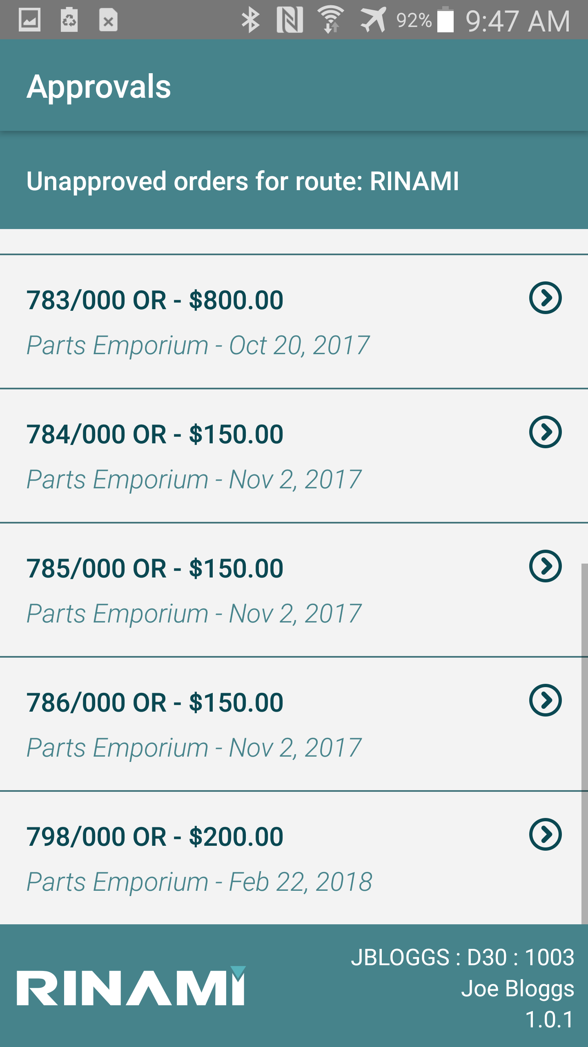
Unapproved Order List
The Unapproved Orders list allows you to review the high-level information about the order waiting to be approved, including the Value, Supplier Name and the Order Date.
Pressing on a displayed line will take you into the detail of the order to be approved (Order Approval screen).
Pressing the back button on the device will return you to the Main screen (Approval Routes List)

Slide 10
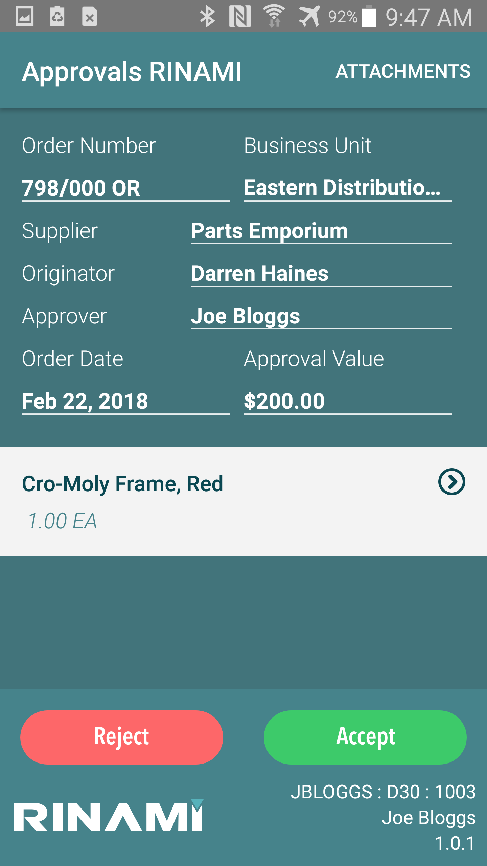
Order Approval
The Order Approval screen displays you the Order Level details about the order as well as a quick view of the individual detail lines of the order (lower section)
The ATTACHMENTS button in the top right will be displayed if there are any attachments against the order to view.
Pressing on any of the detail lines will take you to the line level details screen to show you specific information about the line.
The Accept and Reject buttons will show the enter comments dialog prior to processing the order approval/rejection.

Slide 11
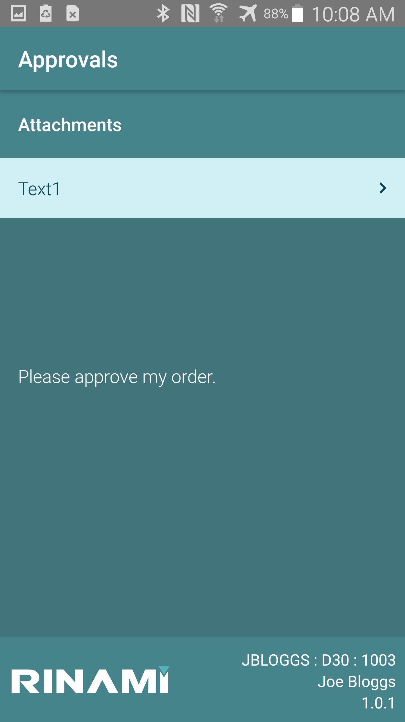
Order Attachments
Pressing the ATTACHMENTS button from the order detail will take you to the attachments screen.
Text, Image, Document and URL attachments will be displayed here.
Clicking on any of the attachment in the list will display the attachment.
Text and Image attachments will be displayed in the lower half of the screen.
Document and URL attachments will be displayed in the default viewer installed on the device for the type of file that is attached.

Slide 12
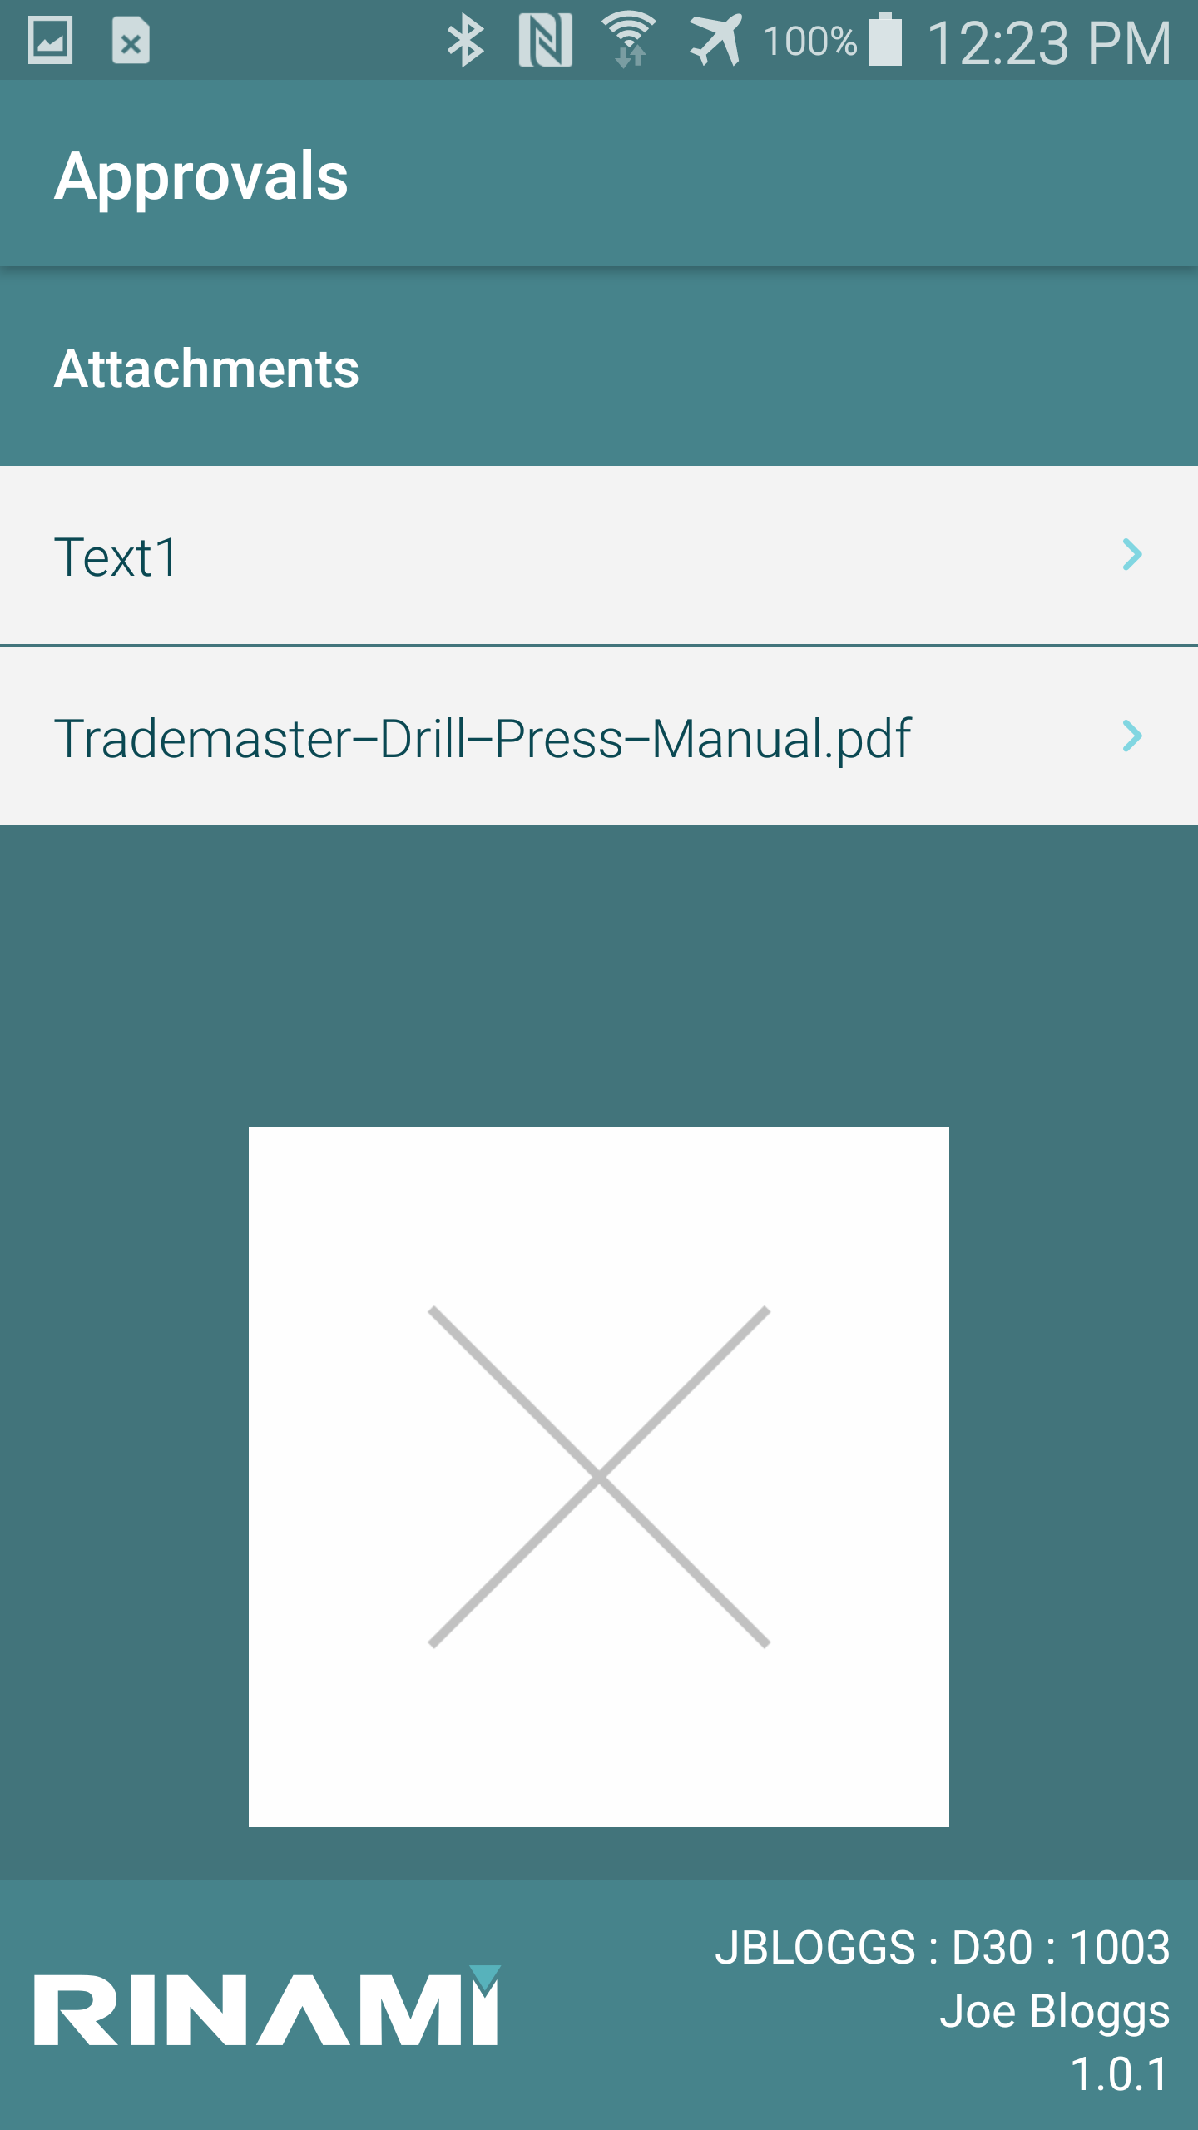
Order Attachments cont…
Attachments will only be downloaded as required by the application, you will see the small arrow pointing to the right once the attachment has been downloaded.
While the attachment is downloading you will see the arrow spinning around.

Slide 13
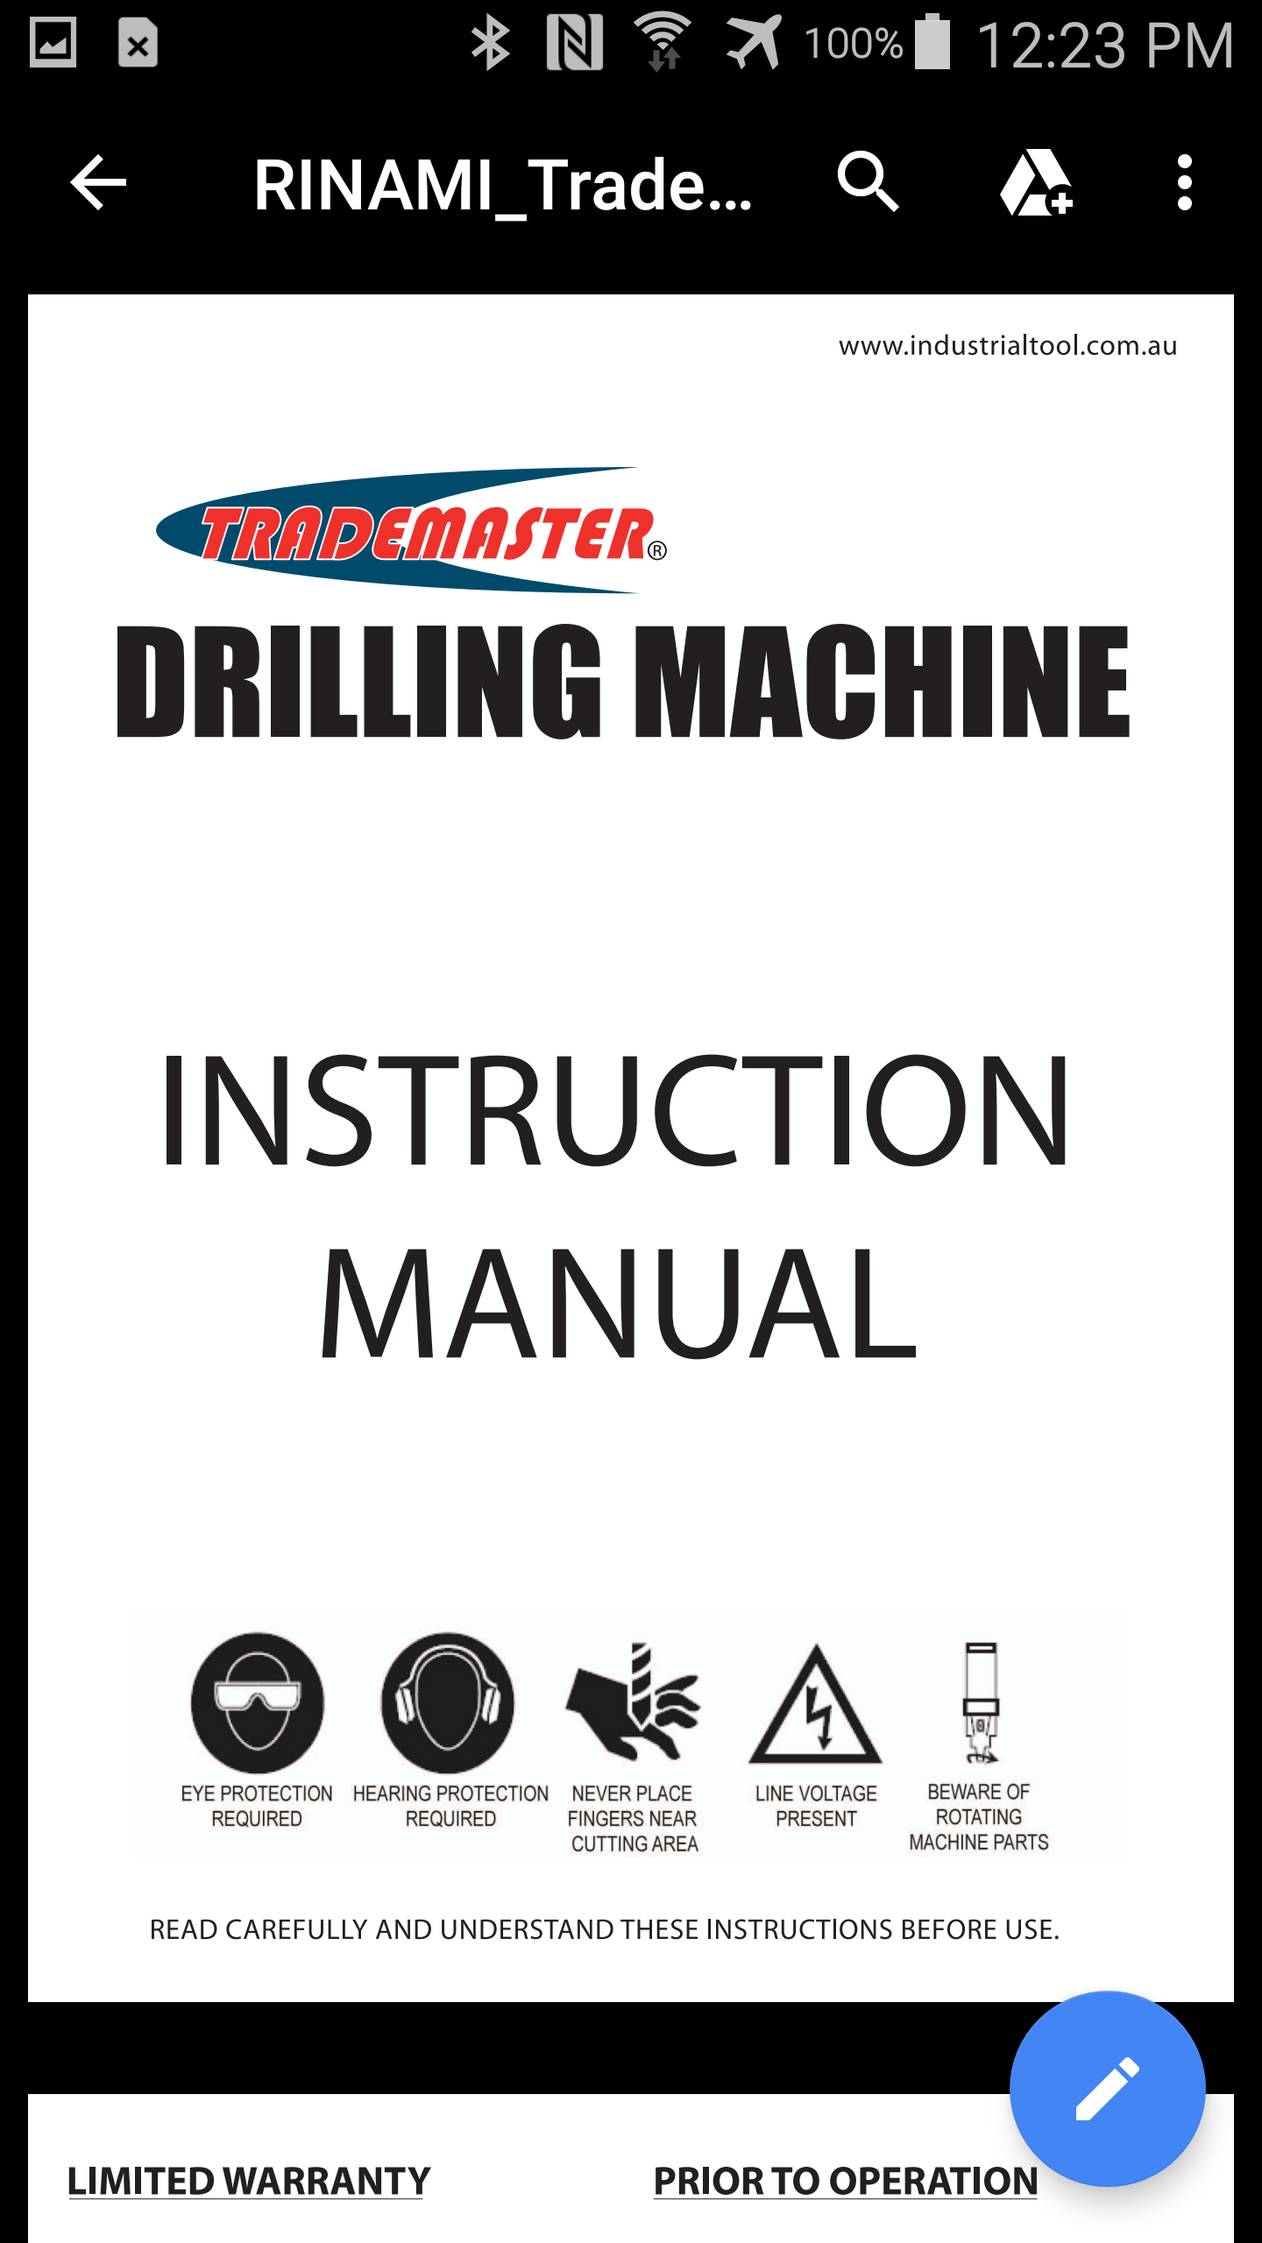
Order Attachments cont…
Document attachments will open in the default application on the device for the type of file being displayed.
To return to the approvals app click the back button in the app (application dependent) or press the BACK button on the device.

Slide 14
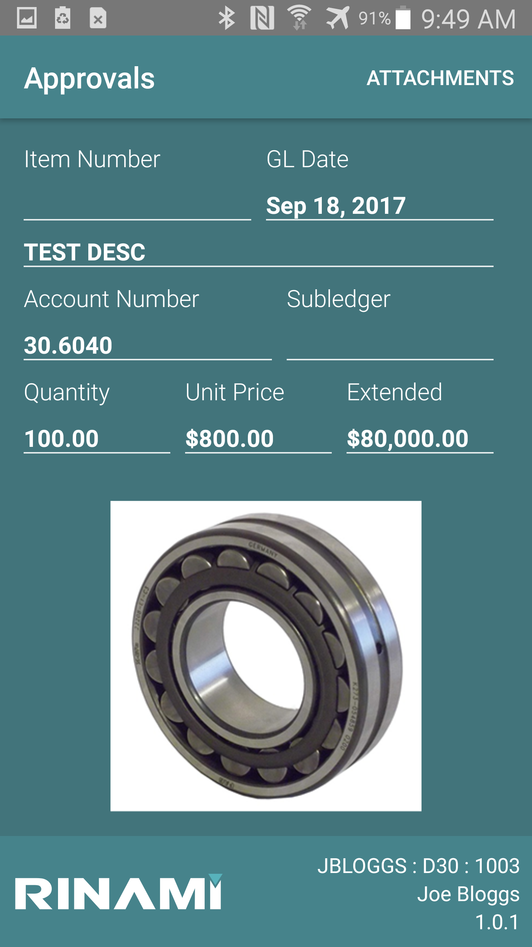
Approval Line Level details
The Line Level Details screen displays the specific line level information about what is being ordered.
Fields Displayed:
Item Number
G/L Date
Line Description 1 and 2
Account Number
Subledger
Quantity
Unit Price
Extended Amount
The default image attachment is also displayed if an attachment has been loaded against the detail line, or the default Item Master attachment if the order is a Stock requisition.

Slide 15
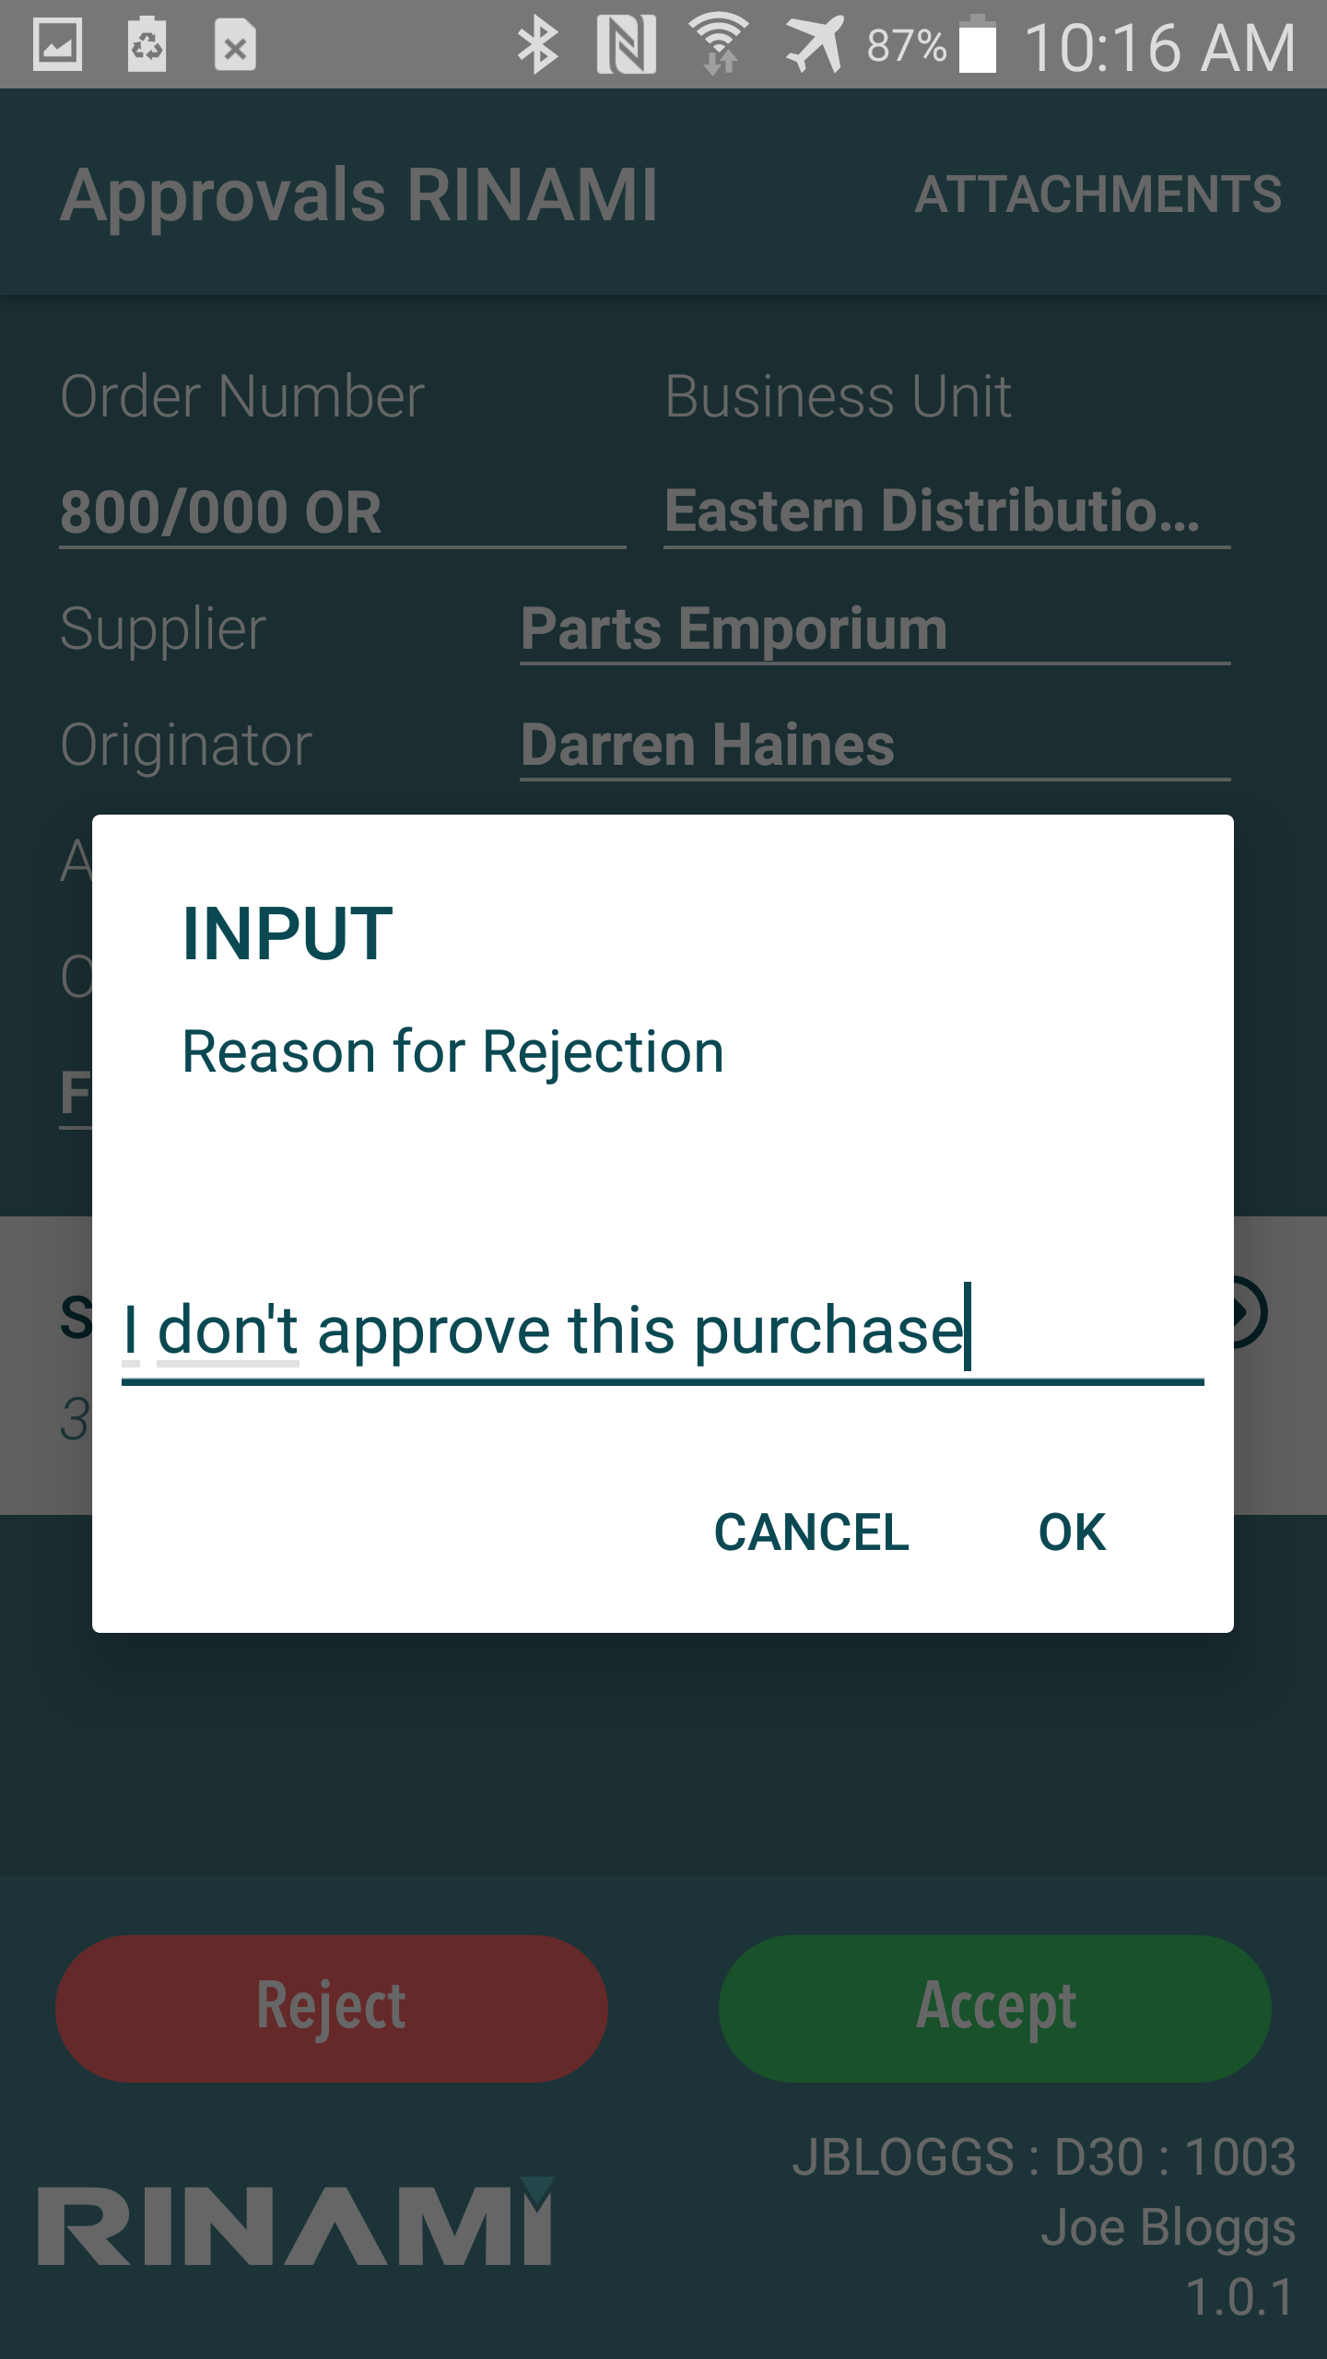
Approve / Reject Approval
Press the Accept or Reject buttons to approve or reject the purchase order/requisition
The user is prompted to provide a comment/reason for the approval/rejection.

Slide 16
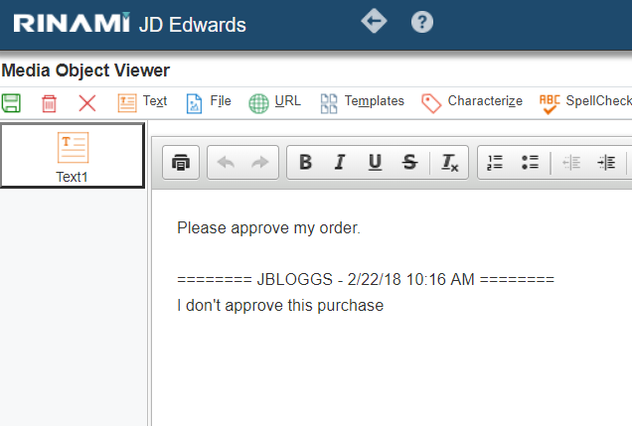
Approve / Reject Approval cont…
The rejection comment is appended to the order header text attachment, clearly identified with the Username, and date/time of the transaction.

Slide 17
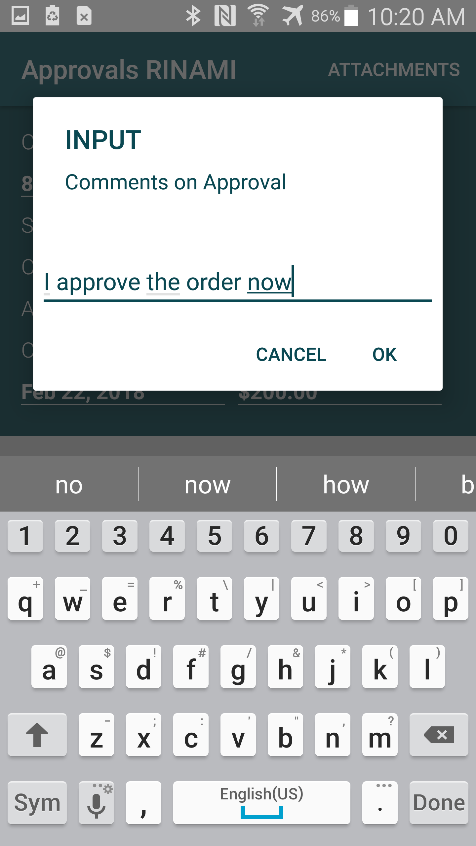
Approve / Reject Approval cont…
Example approval comments.

Slide 18
Push Notifications
*Where required Google Push Notifications setup has been completed within Cantara and appropriate JDE changes applied*
When logging into the approvals application the device identifier will register with Cantara and the Google Push notification service. When approval notifications are recorded within JDE, Cantara will send the notification message.
The notification message is displayed on the device like any other notification you normally see on the device.

Slide 19
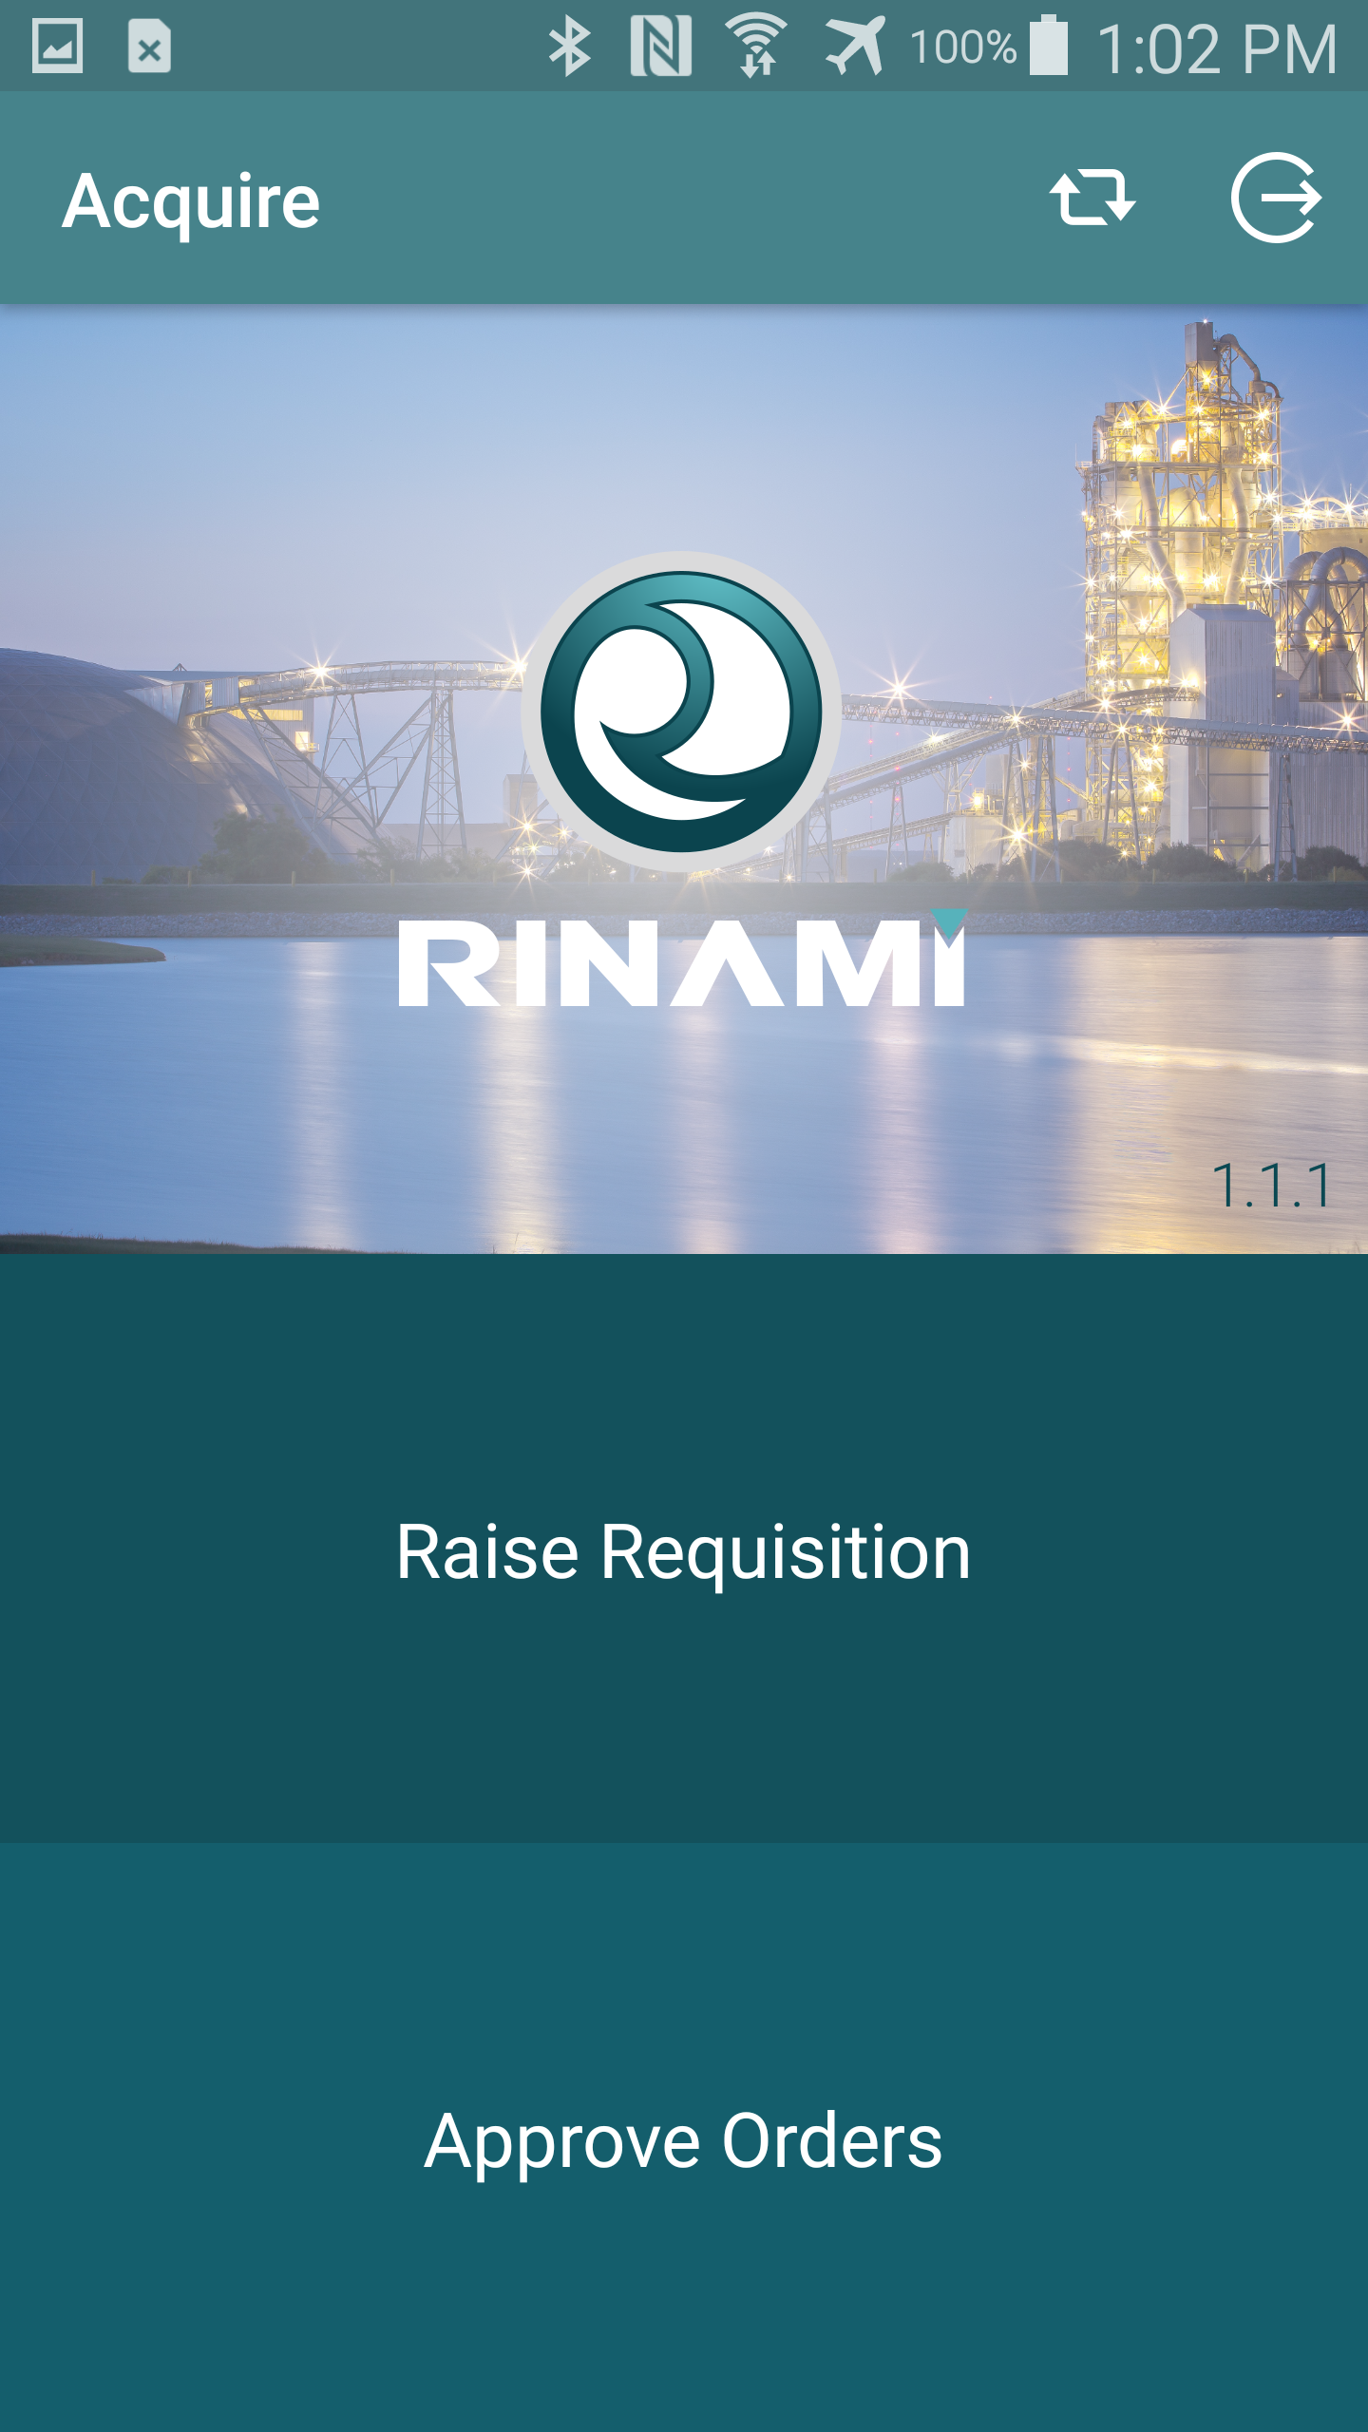
Purchase Order Entry Main Menu
On first login will preload some information such as Business Units, Suppliers and Account Numbers this is required to enable the text searching functionality that simplifies the order creation process.
On the Main Menu you will see large buttons that take you to the Raise Requisition screen or the Approvals App (if incorporated).
In the top menu Reload and Logout buttons are available. The Reload will reload the base data that is stored in the device (suppliers, account numbers, business units). The base data load will also occur if a different user logs into the device.
See the separate guide for the approvals app for the functionality of the Approve Orders screens.

Slide 20
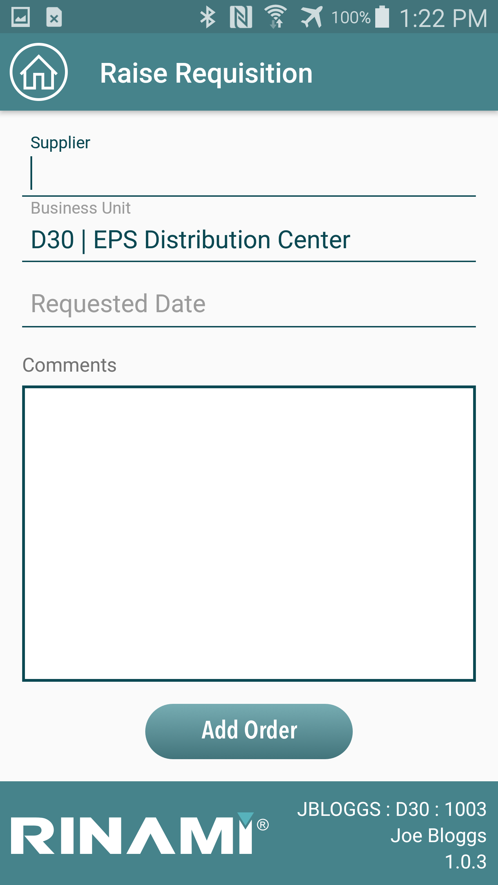
Raise Requisition (Header)
Fill in the details are required:
Supplier
Business Unit
Requested Date
The Business Unit value will default to the user’s default Business Unit if set.

Slide 21
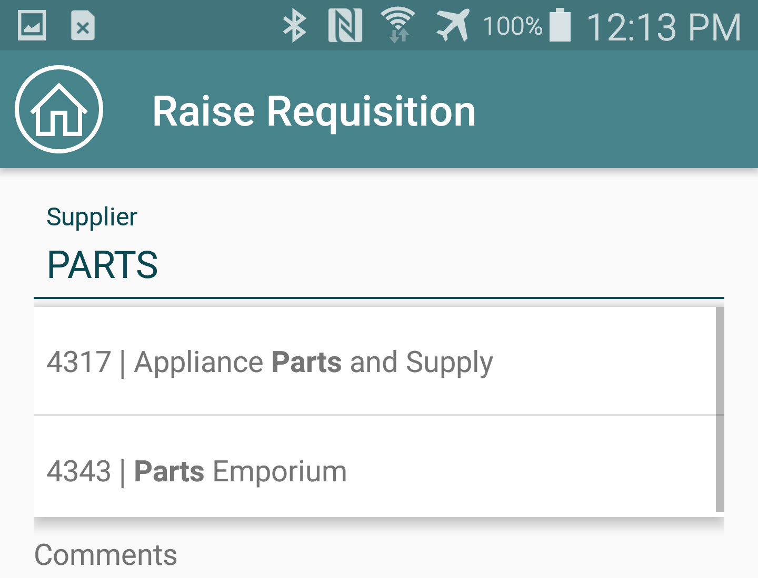
Raise Requisition (Header) cont…
To fill in the Supplier and Business Unit fields start typing the description of the Supplier or Business unit and matches will be displayed.
Press on the desired supplier to apply this to the field.

Slide 22
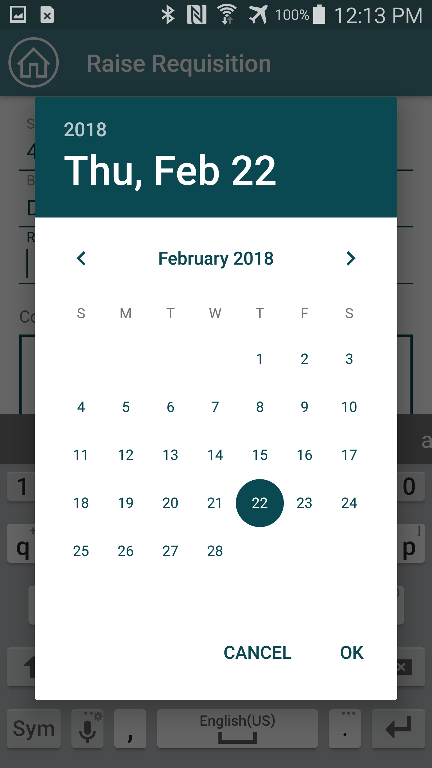
Raise Requisition (Header) cont…
Select a requested date for the requisition by selecting an appropriate date by using the Date picker.

Slide 23
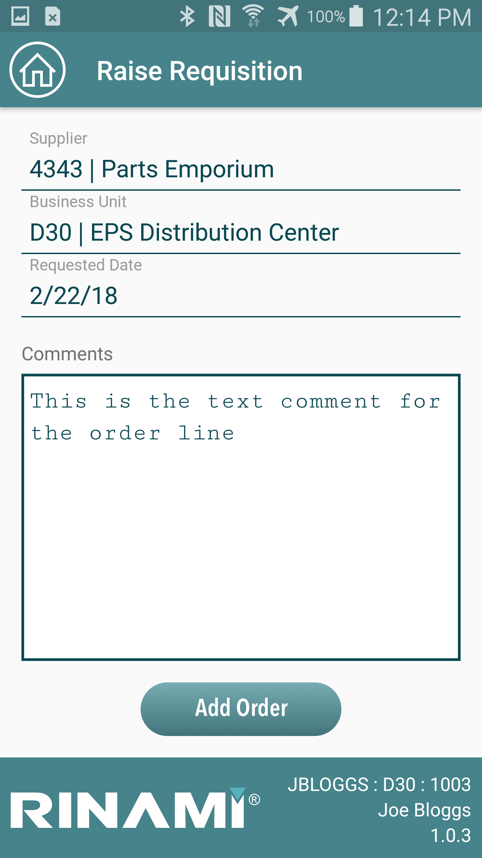
Raise Requisition (Header) cont…
Optionally you can also set the Header text attachment by leaving a comment.
Press the Add Order button to continue to the detail creation step.

Slide 24
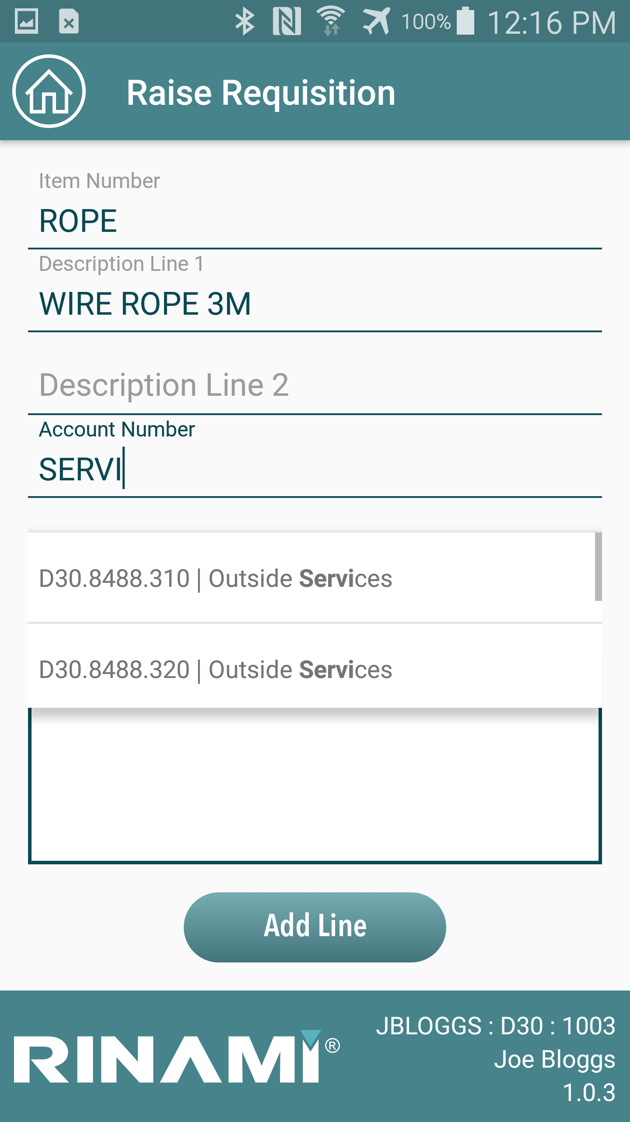
Raise Requisition (Order Line Level Details)
Enter values as required for:
• Item Number
• Description Line 1
• Description Line 2
• Account Number
• Quantity
• Unit of Measure
• Unit Price
• Comments
Enter the Account Number to cost to by typing the description of the account. Accounts that match the entered description will be displayed.

Slide 25
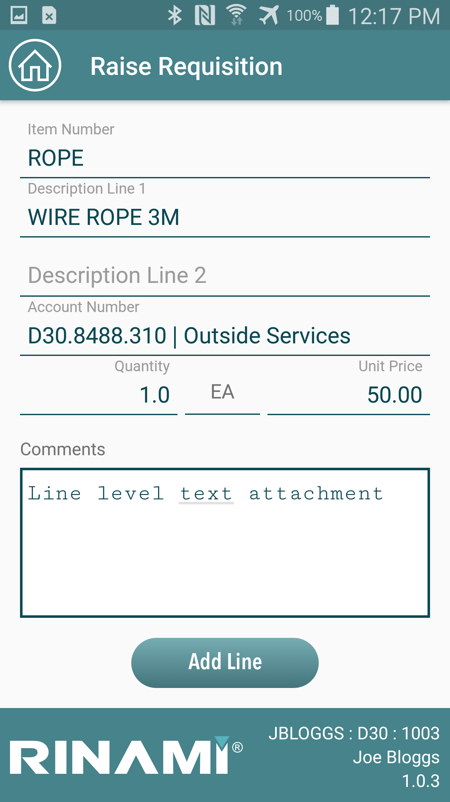
Raise Requisition (Order Line Level Details) cont…
Complete the remaining details required for the line.
Optionally you can enter comments here also, these are the line level text attachments for the purchase order.
Press the Add Line button to compete raising the requisition.
*Note for the Demo field service application the application only raises an order with a single detail line*
The requisition is raised within JDE, if approvals are activated on the purchase order entry version specified for the application, then approval logic will automatically trigger to send the order for approval.

Slide 26
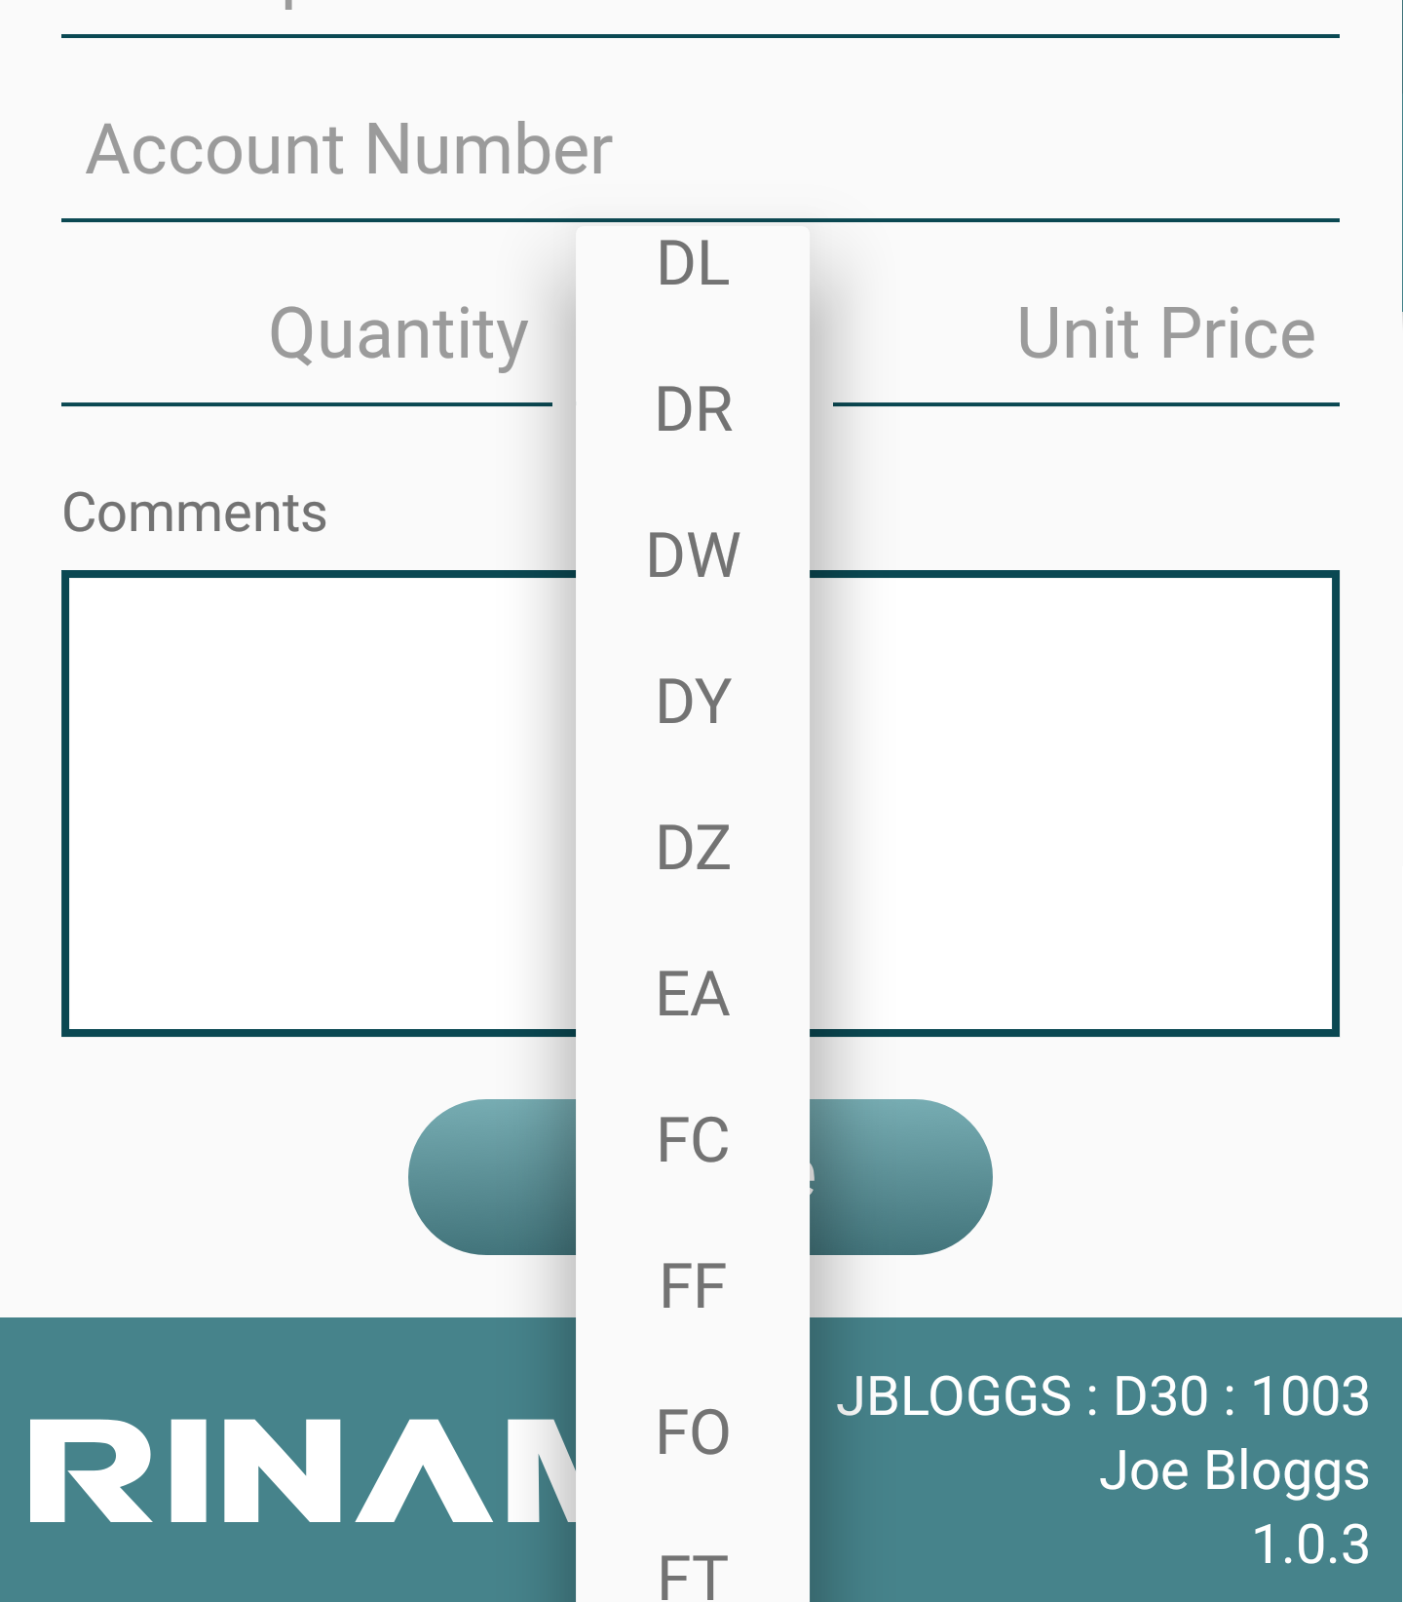
Raise Requisition (Order Line Level Details) cont…
The Unit of Measure for the purchase order can be changed by pressing where you see the field “EA” (Each is the default)
The drop-down list contains all available Unit of Measure values.

